Slide 1




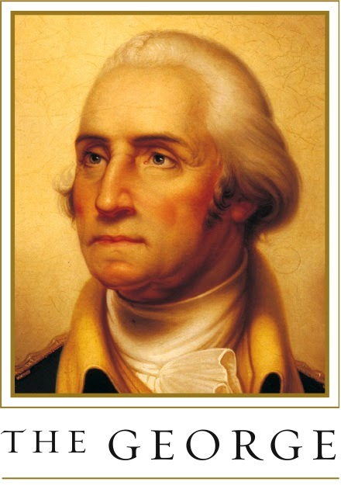

Group #11
START HERE
Covid Risk Dashboard
Present by: Ziyan Guo, Zihao Li, Sihan Adi, Weihang Chen

Slide 2

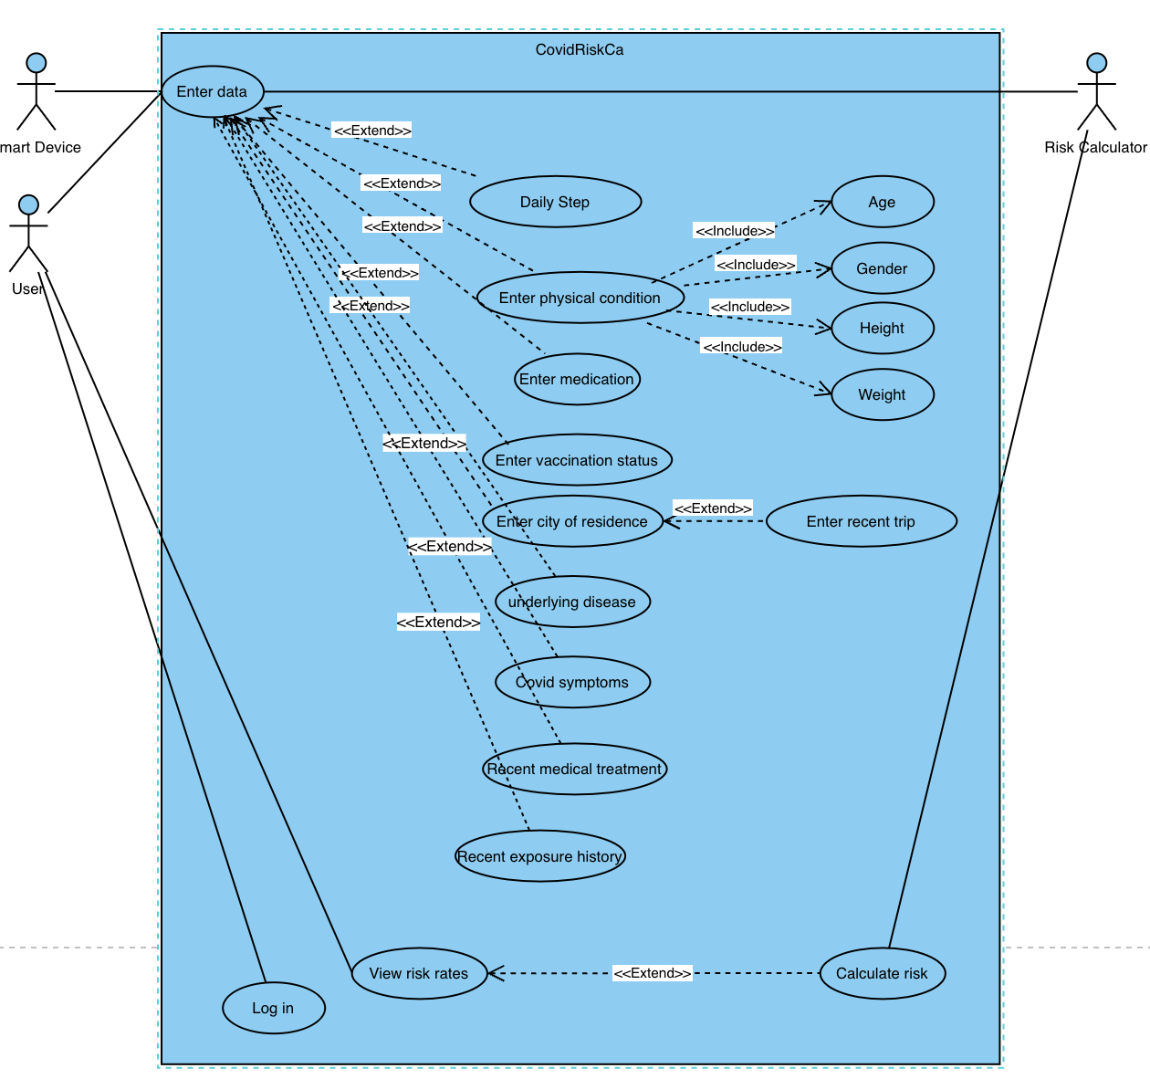
Use Case Diagram
Group 11

Slide 3
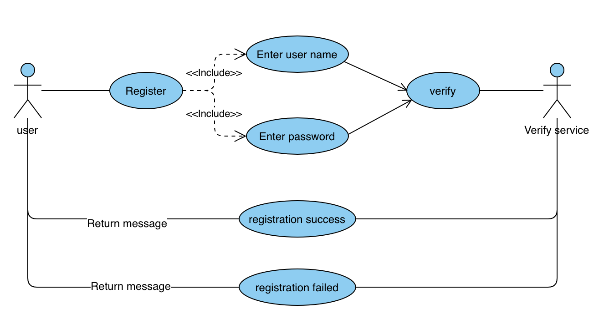
Use Case Diagram
Register
Group 11

Slide 4
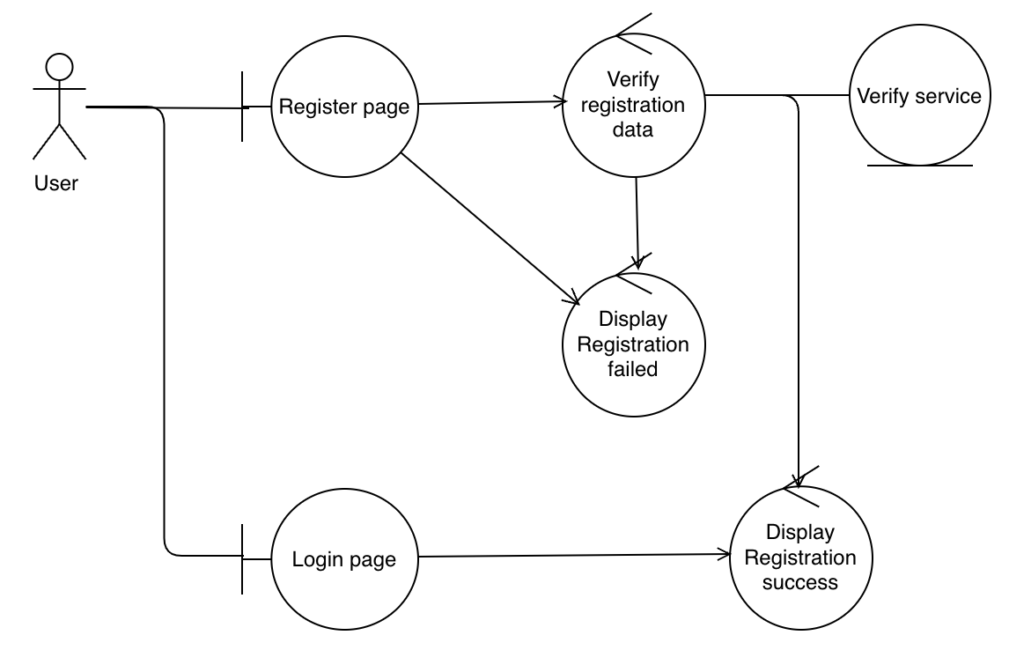
Robustness Diagram
Register
Group 11

Slide 5
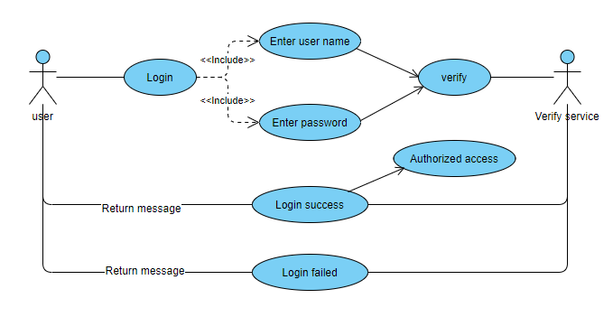
Use Case Diagram
Login in
Group 11

Slide 6
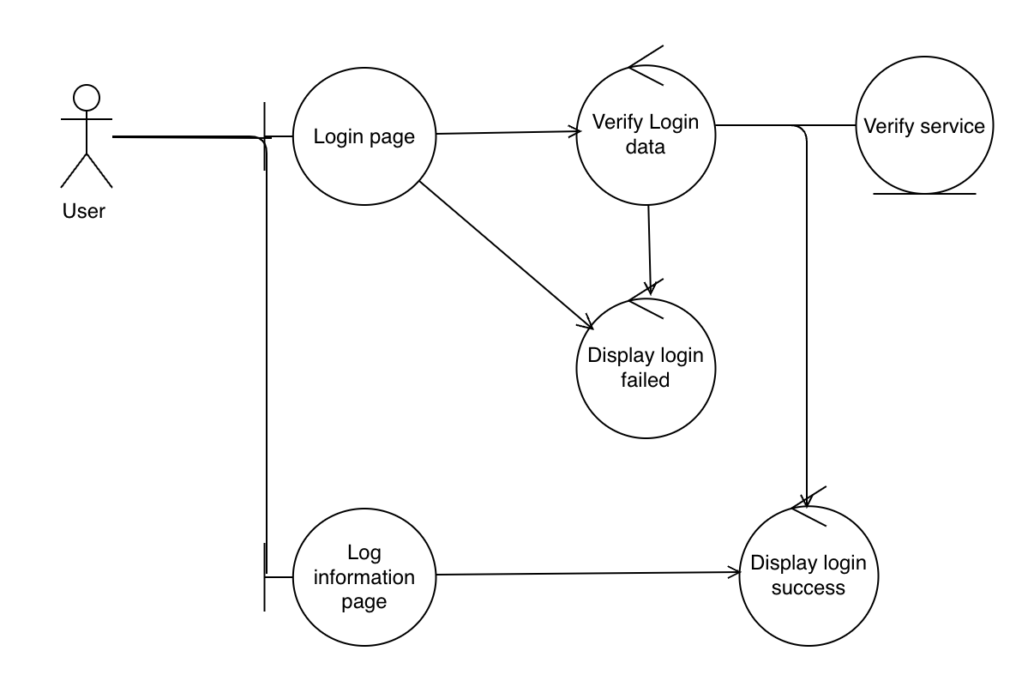
Robustness Diagram
Login in
Group 11

Slide 7
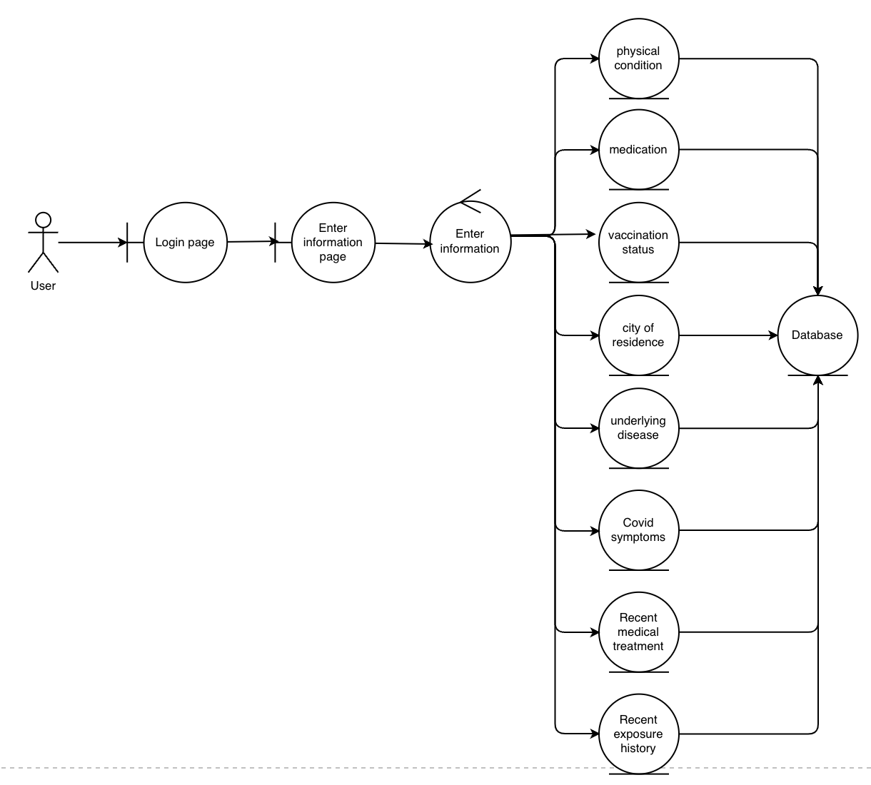
Robustness Diagram
Enter information
Group 11

Slide 8
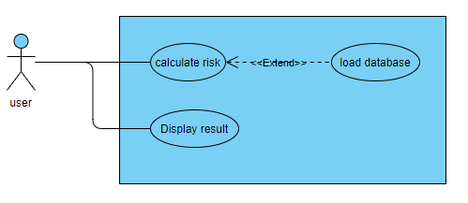
Use Case Diagram
Calculate Risk
Group 11

Slide 9
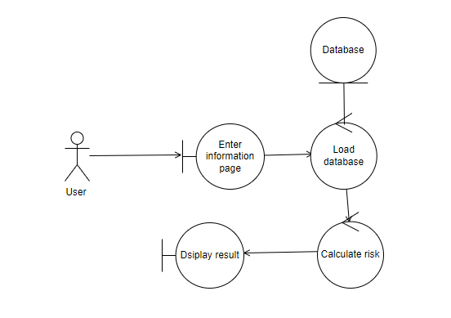
Robustness Diagram
Calculate Risk
Group 11

Slide 10
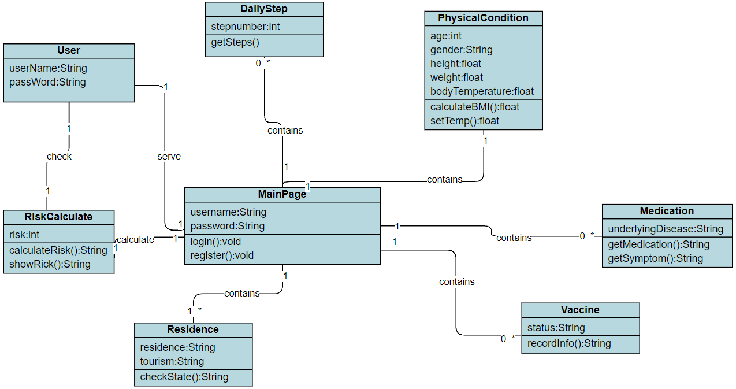
Domain Model
Group 11

Slide 11
Group #11
THANK YOU
Present by: Ziyan Guo, Zihao Li, Sihan Adi,

